Slide 1
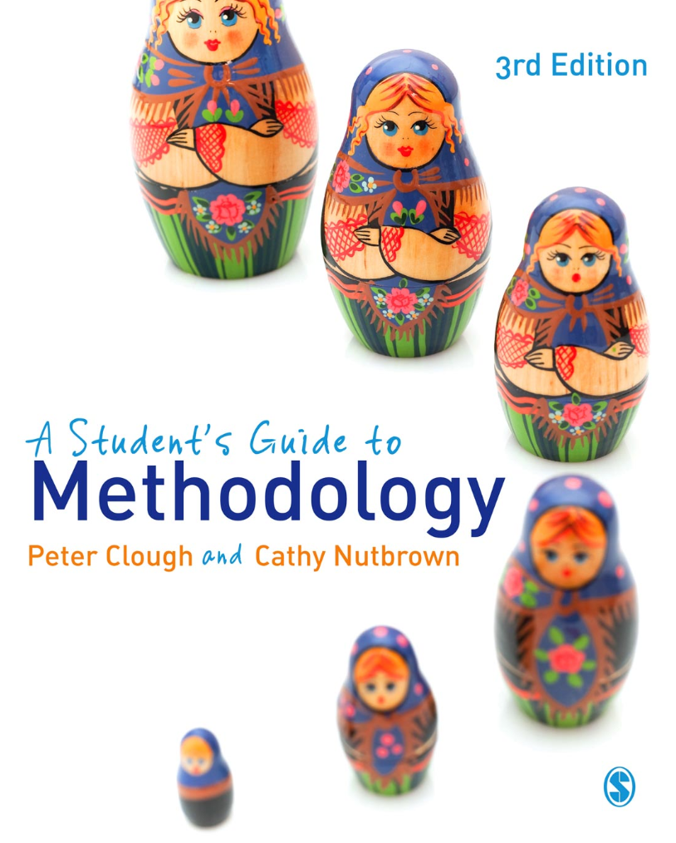
A Student’s Guide to Methodology
Justifying Enquiry
3rd edition
Peter Clough and
Cathy Nutbrown

Slide 2
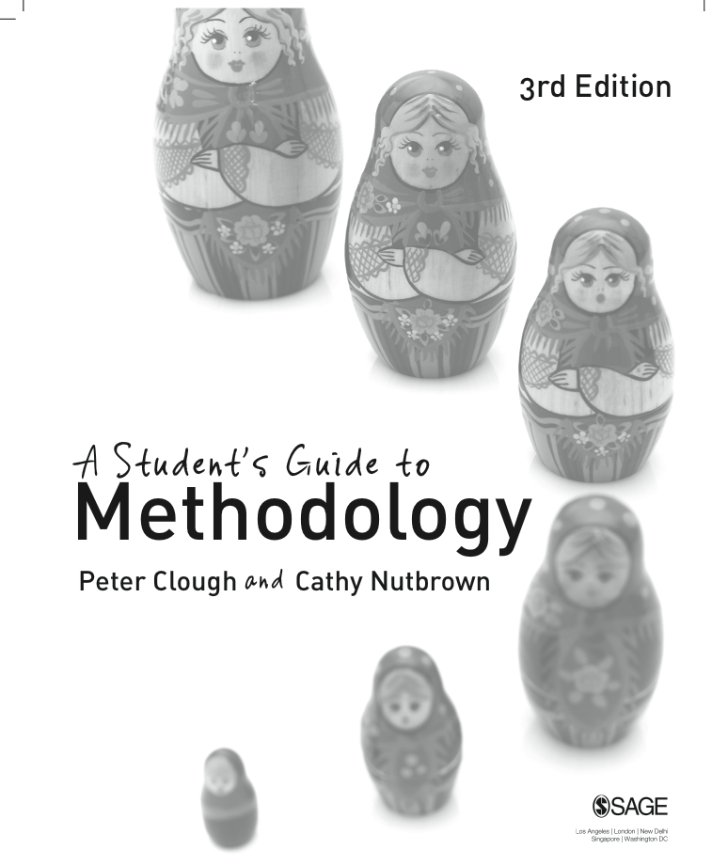
Chapter 1 What is research?
Four ‘p’s’ of social enquiry
‘All social research sets out with specific purposes from a particular position, and aims to persuade readers of the significance of its claims; these claims are always broadly political.’

Slide 3
Social research is persuasive
Those who carry out social research aim to persuade readers of the significance of their claims.

Slide 4
Discussion point
Take some time to think about the following deceptively simple question; it is asked to help you articulate what you mean by ‘research’.
What is ‘research’?
Discuss in a small group and make a few notes in your research journal in response to this question.

Slide 5
Social research is purposive
What is often forgotten (as being too obvious) is that any piece of research in the social sciences emerges from a distinct purpose (whether or not this is apparent to the reader).

Slide 6
Discussion point
In small groups, discuss the following question. It is designed to help you articulate your reasons for doing the particular research study you have chosen.
What is the purpose of your research study?

Slide 7
Social research is positional
Since research is carried out by people, it is inevitable that the standpoint of the researcher is a fundamental platform on which enquiry is developed; all social science research is saturated (however disguised) with positionality.

Slide 8
The positionality of the researcher affects research designs …
Research becomes research when its written report is made public (Stenhouse, 1975) thus giving expression to the standpoint of its authors in a given context. It is the context in which research is designed, conducted and (eventually) reported which gives it its real meaning. Social research does not take place in isolation; people drive research, they identify the emerging issues to be studied and they create – in context – the methods by which situations are further understood, and communicate its outcomes to chosen audiences. The positionality of the researcher affects research designs and processes as well as the ethical practices which are inevitably present throughout any study involving human beings.

Slide 9
Social research is political
Research which changes nothing – not even the researcher – is not research at all. And since all social research takes place in policy contexts of one form or another, research itself must therefore be seen as inevitably political.

Slide 10
Discussion point
In small groups talk about some research papers you have read recently.
What did the authors seek to change?
What impact might it have?
On whom?
On what?

Slide 11
Traditions of enquiry: false dichotomies
All social research sets out with specific purposes from a particular position, and aims to persuade readers of the significance of its claims; these claims are always broadly political.

Slide 12
Discussion point
How helpful is it to consider the ‘distinctive’ nature of a discipline in relation to research paradigms?

Slide 13
Making method/ology
Research is by definition a search for form quite as much and at the same time as it has any content to report; methods should be seen as being constructed (for particular purposes) rather than selected (for any general usefulness).

Slide 14
Ethics: pause for reflection
We have suggested that all research is:
persuasive, purposive, positional and political.
Consider these questions:
What ethical issues should be taken into account in researchers’ intent to make their research persuasive?
What ethical issues underpin the purpose of any research study?
In what ways does the positionality of a researcher determine ethical responses to their research?
If all research is, in one sense or another, political, how does this manifest itself in ethical responses to an enquiry?

